Slide 1
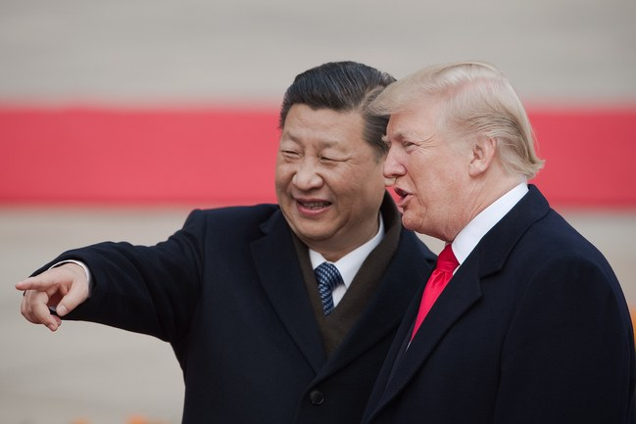
Is China Winning the Trade War ?
https://www.newyorker.com/news/our-columnists/why-china-is-winning-the-trade-war

Slide 2
Is China Winning the Trade War ?
https://www.newyorker.com/news/our-columnists/why-china-is-winning-the-trade-war

Slide 3
Distributed Representation of Chinese Collocation
Bo Xia and Endong Xun

Slide 4
Distributed Representation of Chinese Collocation
Bo Xia and Endong Xun

Slide 5
Introduction
What is collocation?
Why collocation is meaningful for us?
How to represent a collocation?

Slide 6
What is collocation?
Introduction
English collocation

Slide 7

What is collocation?
Notes:
Collocation examples from compulsory English lesson

Slide 8
decrease to
die out
in peace
burst into laughter
appreciate doing sth
before long
for sure
in relief
according to
have an effect on
in danger of
protect A from B
long before
come into being
so that
pat attention to
in such a short time
succeed in doing sth
Notes:
Collocation examples from compulsory English lesson

Slide 9
What is collocation?
Introduction
English collocation
Chinese collocation

Slide 10
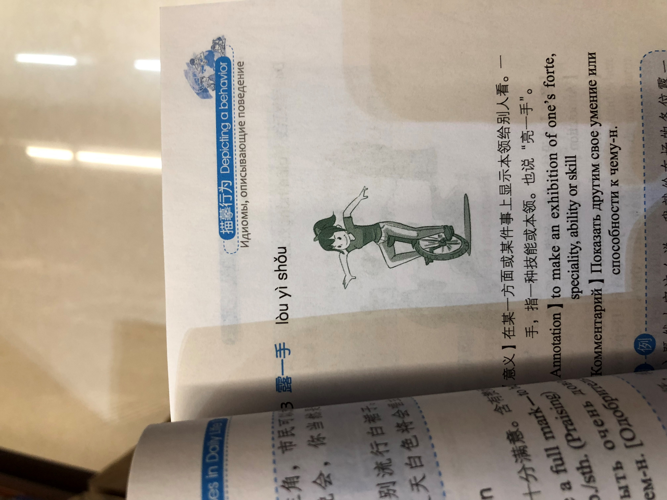
Chinese collocation
Introduction
露一手
【Annotation】
to make an exhibition of one’s forte, speciality, ability or skill

Slide 11
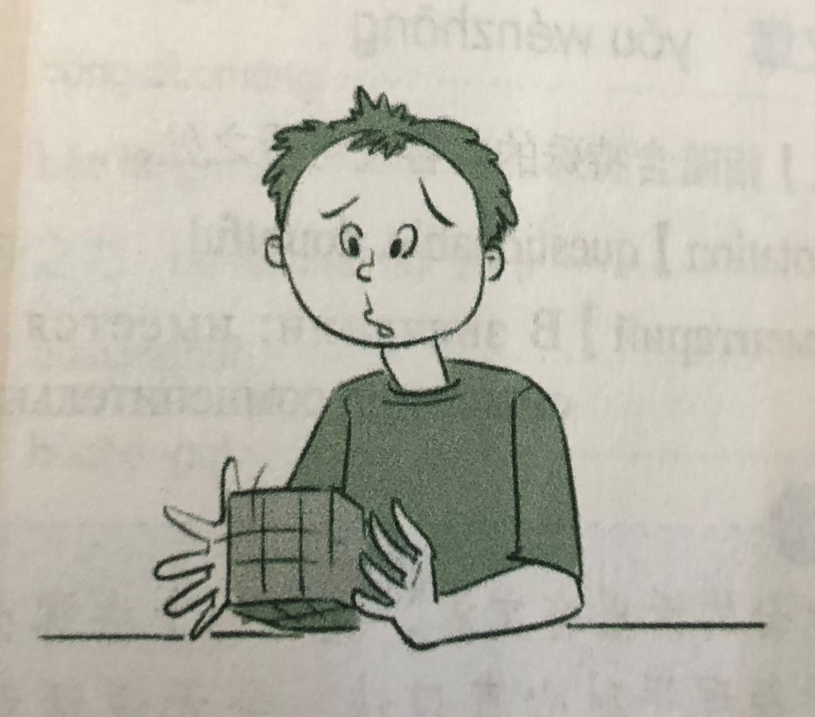
Chinese collocation
Introduction
伤脑筋
【Annotation】
Knotty, troublesome, causing sb. enough headache

Slide 12
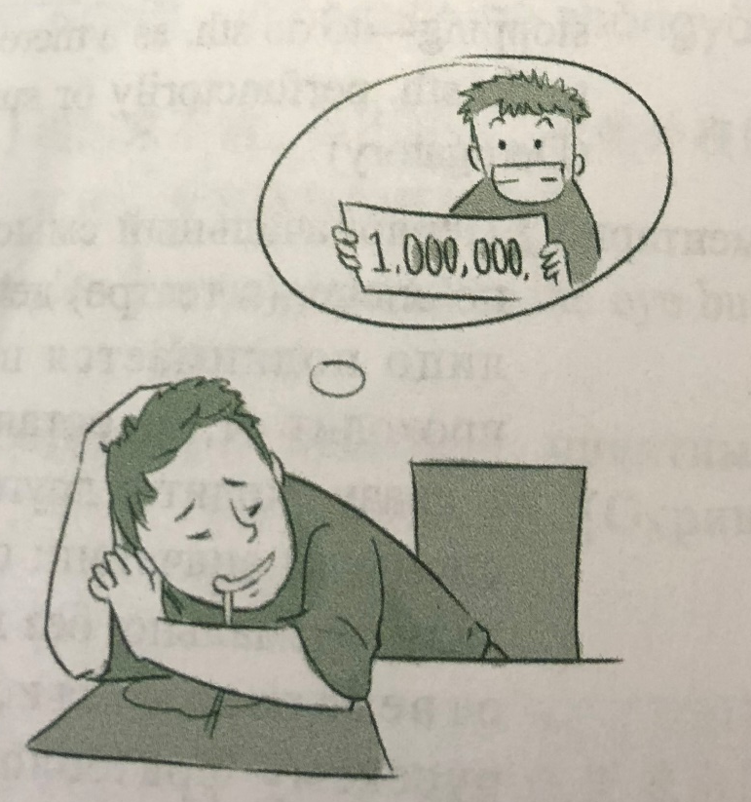
Chinese collocation
Introduction
做白日梦
【Annotation】
To build castles in the air, to daydream(Ironic)

Slide 13
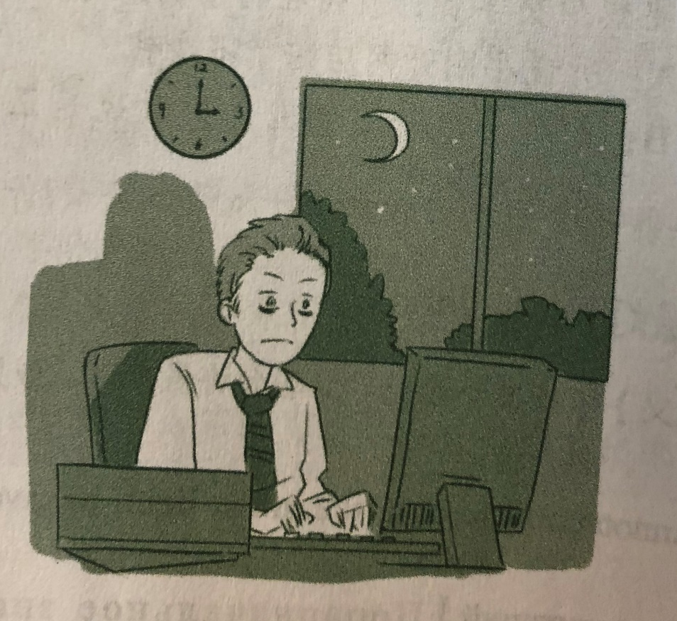
Chinese collocation
Introduction
开夜车
【Annotation】
To drive at night – to work late into the night or by candlelight, to put in extra time at night, to burn the midnight oil.

Slide 14
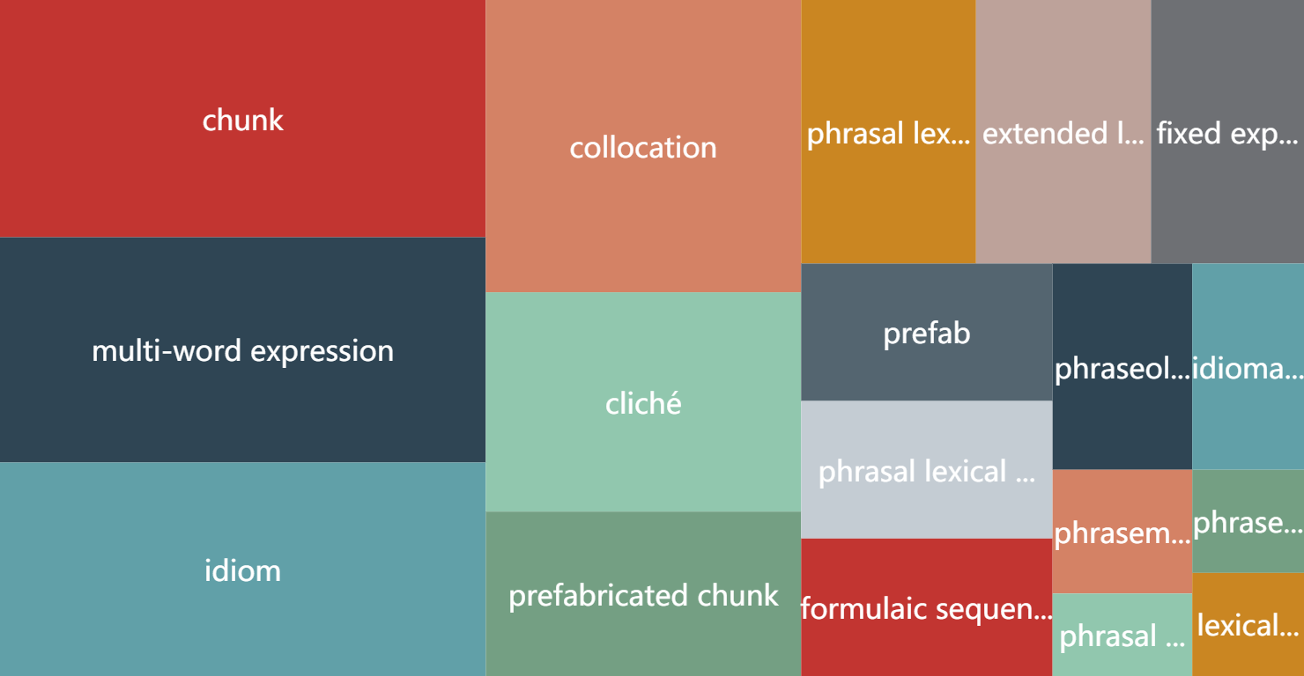
What is collocation?
Notes:
{name: 'collocation', value: 160},
{name: 'idiom', value: 180},
{name: 'chunk', value: 200},
{name: 'multi-word expression', value: 190},
{name: 'cliché', value: 90},
{name: 'extended lexical unit', value: 80},
{name: 'fixed expression', value: 70},
{name: 'formulaic sequence', value: 60},
{name: 'idiomatic expression', value: 40},
{name: 'lexical phrase', value: 20},
{name: 'phraseme', value: 30},
{name: 'phraseologism', value: 20},
{name: 'phraseological unit', value: 50},
{name: 'phrasal lexical item', value: 60},
{name: 'phrasal lexeme', value: 20},
{name: 'phrasal lexeme', value: 80},
{name: 'prefabricated chunk', value:90},
{name: 'prefab', value: 60},

Slide 15
Why collocation is meaningful for us?
Introduction
Important role of language phenomenon in syntactic and semantic,
But need to use it well.
look up
bus stop
Notes:
通过歧义的例子，表达清楚搭配是一个重要的概念，搭配处理得好，parsing就能处理的好，其他任务也能处理的好

Slide 16
How to represent a collection?
Introduction
Lexicon
Table
Triple
Rules, Features or labels
e.g.
< ‘make’ , ‘decision’ >
< ‘make’ , ‘decision’, ‘verb–object’ >
Notes:
截图对应的描述方法

Slide 17
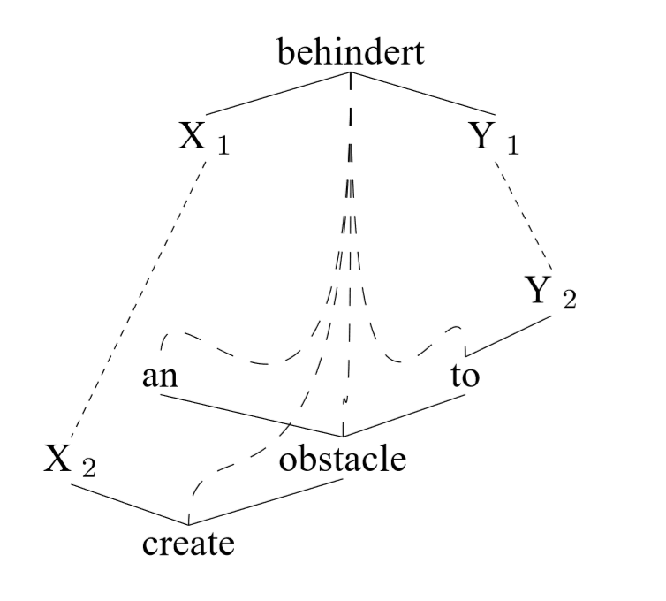
Example of a typical syntactic MWE configuration

Slide 18
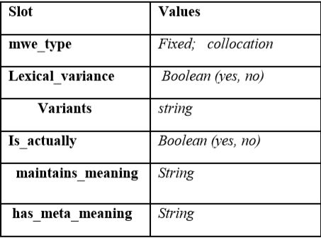
A conceptual lexicon
Development of a lexicon
of the encoding of MWEs
and their treatments.
Example of encoding schema for nouns & verbs

Slide 19
Basic Notions
A Neural Probabilistic Language Model
Collocation
NNLM + Collocation = ?

Slide 20

Basic Notions
A Neural Probabilistic Language Model
Collocation
NNLM + Collocation = ?

Slide 21
Basic Notions
A Neural Probabilistic Language Model
Collocation
NNLM + Collocation =
Distributed Representation of Chinese Collocation

Slide 22
Basic Notions
“
By collocation,
we mean a directed association of head word and dependency word
that constructed by fully random combination
in a sentence.
”

Slide 23
Model Architecture

Slide 24
The objective of Collocation prediction
Model Architecture
P (Context(HEAD) | DEP)

Slide 25
Continuous Skip-gram Model
Model Architecture

Slide 26
A combination of ontology and hierarchical softmax
Model Architecture

Slide 27
Experiment

Slide 28
Experimental setup
Experiment

Slide 29
Neighbors of one collocation
Experiment

Slide 30
Measuring collocation intensity
Experiment

Slide 31
Verb-verb phrase recognition
Experiment

Slide 32
Conclusion and future work

Slide 33
Distributed Representation of Chinese Collocation
Bo Xia and Endong Xun
Beijing language and culture university
https://github.com/xiabo0816/Chinese_MWEs_Representation

Slide 34
Distributed Representation of Chinese Collocation
Bo Xia and Endong Xun Beijing language and culture university

